Slide 1
Comparing Different Techniques in METTL3 Knockdown
Wenyi Shao

Slide 2
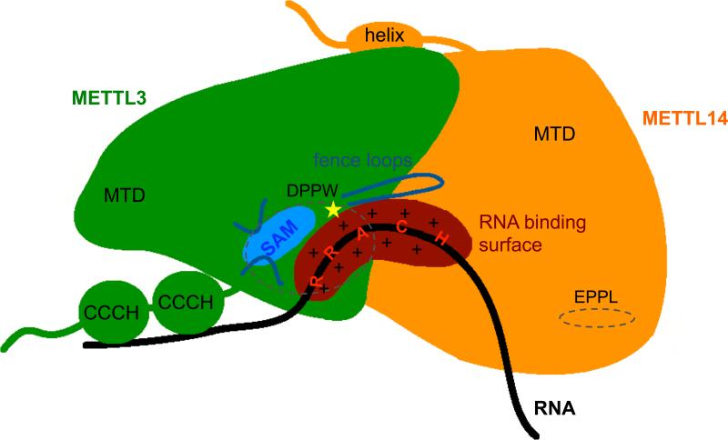
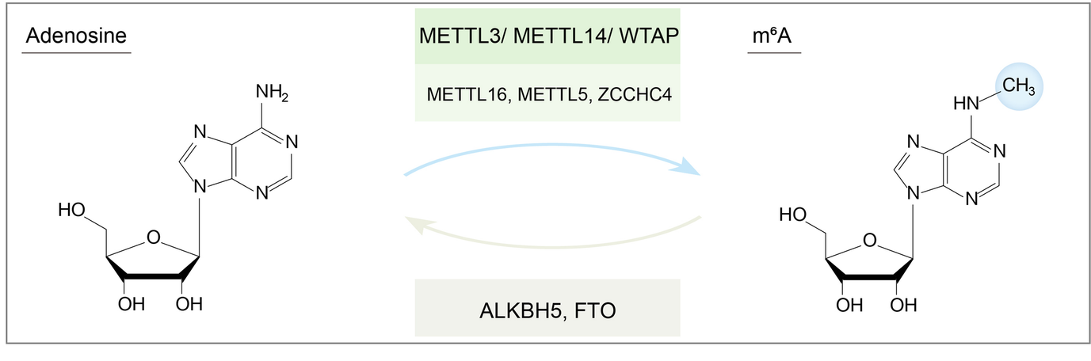
Background
N6-methyladenosine (m⁶A) is the most abundant mRNA modification
METTL3 protein: a subunit in the writer of m⁶A
https://jhoonline.biomedcentral.com/articles/10.1186/s13045-020-00951-w
https://www.ncbi.nlm.nih.gov/pmc/articles/PMC5109923/
Notes:
MTC is the complex

Slide 3
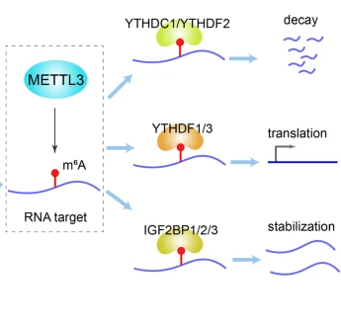
Background
m⁶A reader
RNA modifications decide RNA fate
METTL3 often relates to cancer progression
Effects of METTL3 knockdown on cancer
https://jhoonline.biomedcentral.com/articles/10.1186/s13045-020-00951-w

Slide 4
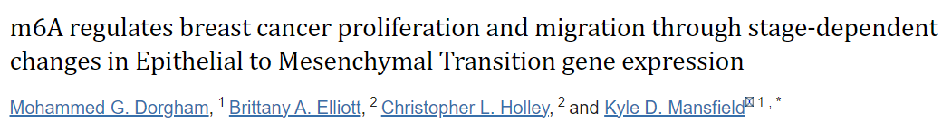
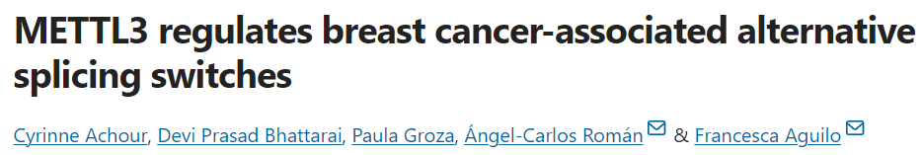
Question
Do different METTL3 knockdown techniques change overall gene expression in cells?
Paper 1
Paper 2
Notes:
Both are published in 2023

Slide 5
Dataset differences
 | Paper 1 | Paper 2
Knockdown method | CRISPR-Cas9 knockdown | siRNA knockdown
Breast cancer cell line | MCF10-A | MCF10-A
Cell source | Karmanos Cancer Center (U.S.) | Sweden
Conditions | 3 Control vs. 3 KD | 2 Control vs. 4 KD (2 siRNA)
Strandedness | Stranded | Unstranded
Library prep method | Ribodepletion | PolyA enrichment
Sequencing platform | Illumina NextSeq 2000 system | Illumina HiSeq 2500 platform
Read length | 100 bp, paired-end | 150 bp, paired-end
Notes:
Spontaneously immortalized non-tumorigenic breast cell line, a control cell line

Slide 6
Workflow
Download data
Quality control & trimming
Alignment to reference genome
Gene expression quantification
Gene expression analysis
NCBI
BioStudies
FastQC
TrimGalore
STAR
GRCh38 NCBI RefSeq
QoRTs
featureCounts
VST normalization
DESeq
GO
GSE

Slide 7
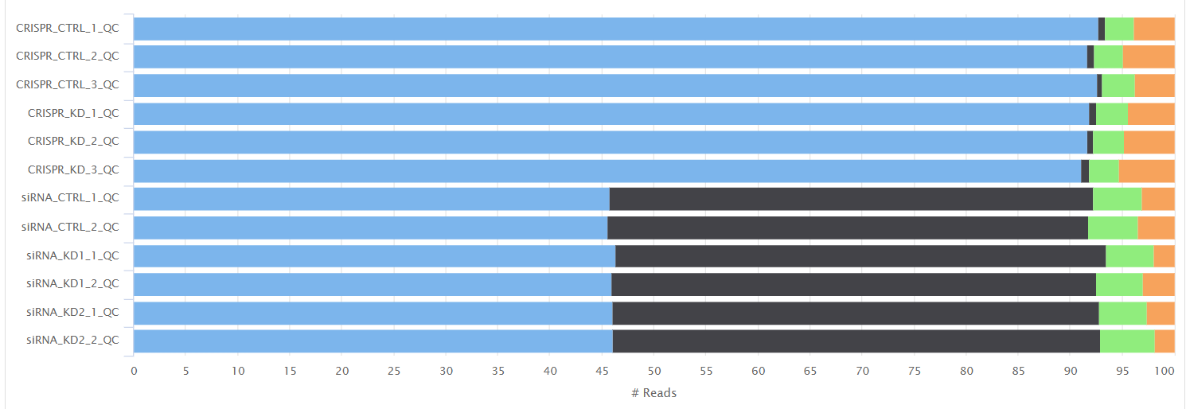
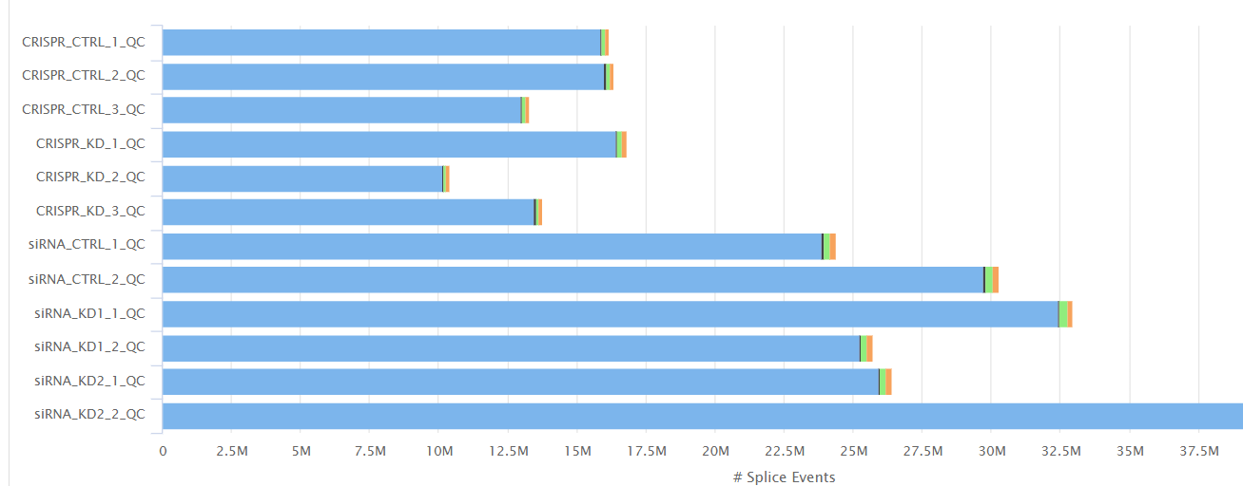
Results: QC
Strandedness
Similar FastQC results on raw reads: read quality, sequence counts, etc.
Similar alignment QC results: alignment locations, splice loci, STAR alignment scores, featureCount assignments
Splice Events
Notes:
Longer read length leads to more splicing?

Slide 8
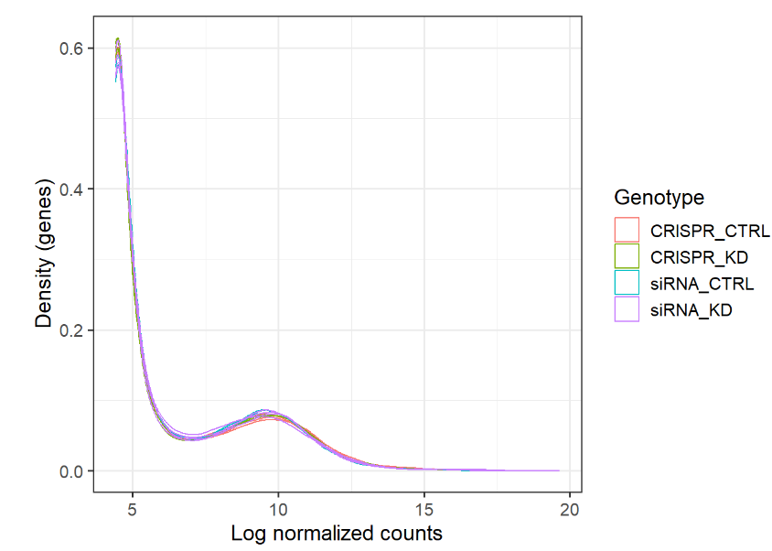
Results: Normalization

Slide 9
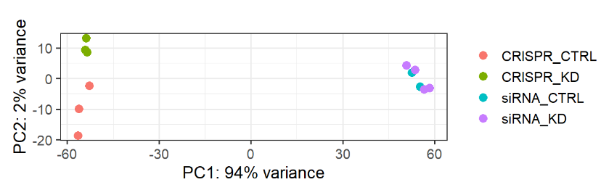
Results: DGE
 | Significant | Not significant
CRISPR_CTRL vs. CRISPR_KD | 835 | 16385
siRNA_CTRL vs. siRNA_KD | 4 | 32211
CRISPR_CTRL vs. siRNA_CTRL | 7953 | 12390

Slide 10
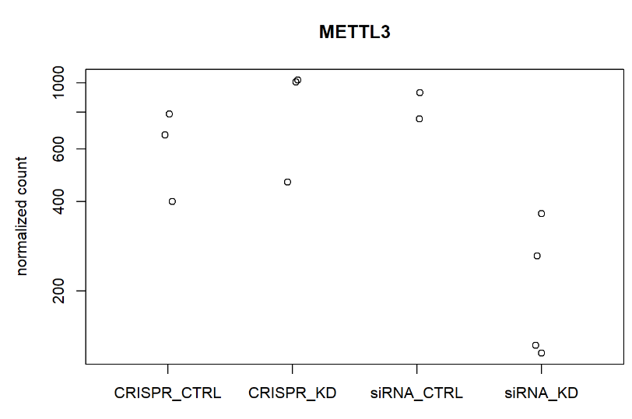
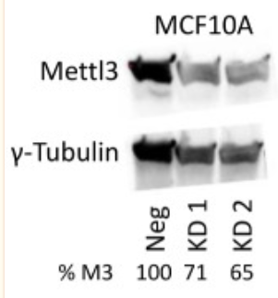
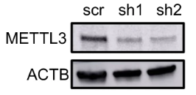
Results: METTL3 expression
CRISPR
siRNA

Slide 11
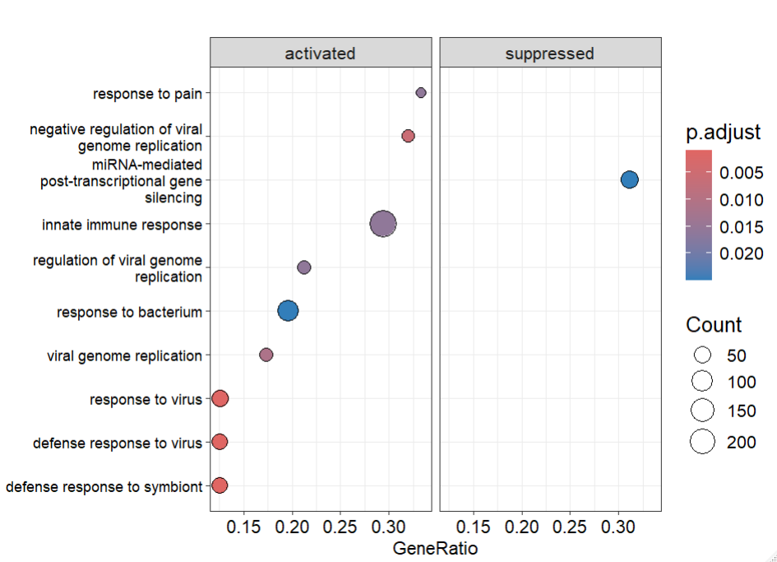
Results: GO
CRISPR_CTRL vs. CRISPR_KD

Slide 12
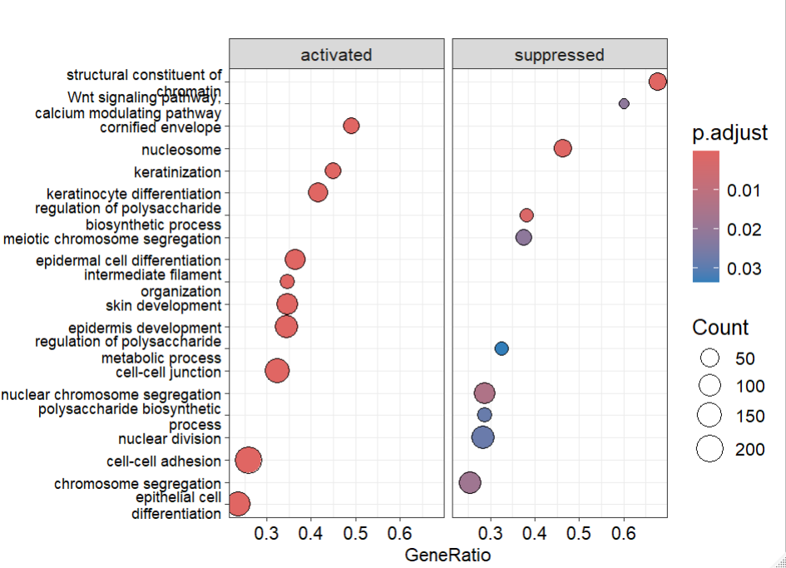
Results: GO
CRISPR_CTRL vs. siRNA_CTRL

Slide 13
Conclusions
In METTL3 knockdown, CRISPR-Cas9 leads to larger difference in gene expression in cells compared to siRNA
There are differences in gene expression even for the same cell line

